Slide 1
Rich Call Display
What is it and How does it work?
Notes:
How many of you guys have heard of Rich Call Display?
How many of you have received a call that’s has a branded logo on it?

Slide 2
Robocall Epidemic
Consumer trust has eroded in the phone due to the robocall epidemic.
US consumers receive 4.5 – 5 billion robocalls per month.
The first 5 months of 2025 saw an 11% increase versus 2024.

Slide 3
STIR/SHAKEN Framework
The FCC mandated carriers to authenticate calls that originate on its network with the goal of enabling the possibility for traceback & enforcement.
Prior to STIR/SHAKEN, it was difficult to traceback the source of the VOIP caller.
These standards are responsible for requiring your carrier to sign every call that your business places.
Notes:
While STIR/SHAKEN has reduced number spoofing, legacy CNAM databases currently remain the only widespread source of caller name information, but because those databases reportedly are not reliably accurate and are subject to manipulation, concerns exist about their continued use.12 Rich Call Data (RCD) and other potential solutions that capitalize upon the capabilities of IP networks offer alternatives to CNAM databases for transmission of caller identification information.

Slide 4
STIR/SHAKEN Framework
The FCC’s goal with mandating call authentication, was to establish accountability with carriers passing illegally spoofed robocall traffic.
With each call signed with an attestation, the enforcement bureaus can now trace the source of illegal robocall traffic.
Which the FCC has been very active with enforcement against telecom fraud.
Notes:
95% of call traffic between those top carriers was signed with “A level” attestation. This enables the operators to establish SIP-to-SIP connections between originating and terminating parties, preventing robocall bad actors from infiltrating tier-1 networks.
However, despite tier-1 carriers’ positive momentum, the percentage of signed calls between non-top carriers fell by nearly 25% in 2024. Robocall bad actors have exploited these providers’ reliance on legacy TDM circuits — and the dropping of the original STIR/SHAKEN information— to hide malicious, unwanted robocall traffic.

Slide 5
STIR/SHAKEN and Rich Call Data
Rich Call Data (RCD) is an extension of STIR/SHAKEN that carries signed caller identity details, such as name, logo, and call reason to display to the called recipient.
There is NOTHING stopping you from adding enhanced caller information today, but the TSPs will refuse to display it due to the lack of trust and inability to authenticate the validity of rich call information.
Notes:
95% of call traffic between those top carriers was signed with “A level” attestation. This enables the operators to establish SIP-to-SIP connections between originating and terminating parties, preventing robocall bad actors from infiltrating tier-1 networks.
However, despite tier-1 carriers’ positive momentum, the percentage of signed calls between non-top carriers fell by nearly 25% in 2024. Robocall bad actors have exploited these providers’ reliance on legacy TDM circuits — and the dropping of the original STIR/SHAKEN information— to hide malicious, unwanted robocall traffic.

Slide 6
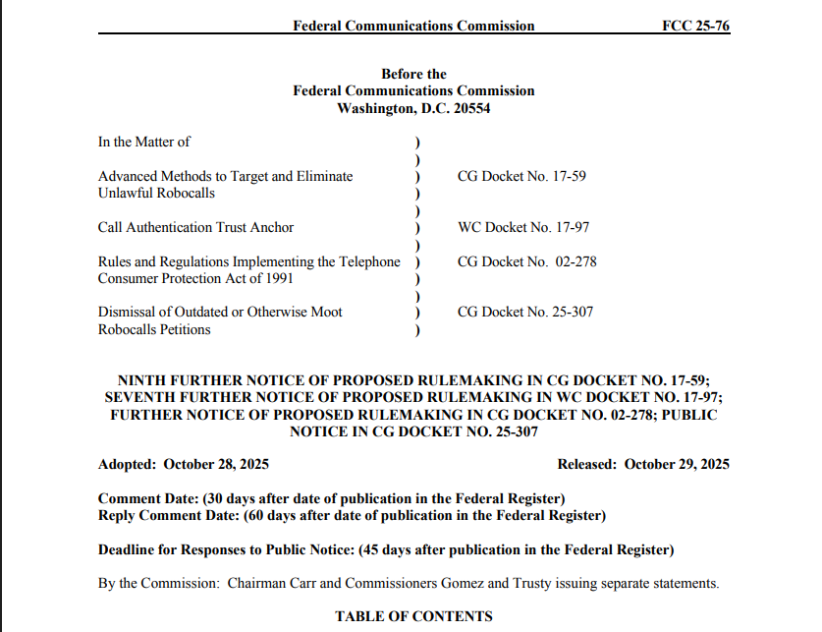
FCC’s FNPRM
The FCC published a recent FNPRM specifically inquiring about Rich Call Data, and whether they should mandate the carriers to support and use Rich Call Data.
Notes:
While STIR/SHAKEN has reduced number spoofing, legacy CNAM databases currently remain the only widespread source of caller name information, but because those databases reportedly are not reliably accurate and are subject to manipulation, concerns exist about their continued use.12 Rich Call Data (RCD) and other potential solutions that capitalize upon the capabilities of IP networks offer alternatives to CNAM databases for transmission of caller identification information.

Slide 7
FCC’s FNPRM
“In this Notice, we propose to require that providers give consumers accurate caller name and other information that enables them to regain control of their phones by ensuring they no longer have to guess whether a call is one they want to pick up”
“Specifically, we propose to require TSPs to transmit verified caller name for presentation on consumers’ handsets whenever they transmit call authentication information indicating that the originating number is unlikely to be spoofed.”
Notes:
While STIR/SHAKEN has reduced number spoofing, legacy CNAM databases currently remain the only widespread source of caller name information, but because those databases reportedly are not reliably accurate and are subject to manipulation, concerns exist about their continued use.12 Rich Call Data (RCD) and other potential solutions that capitalize upon the capabilities of IP networks offer alternatives to CNAM databases for transmission of caller identification information.

Slide 8
Consumer Trust
Consumers are simply reluctant to answer calls from unknown numbers.
The Caller ID Remediation product is great from removing inaccurate spam labels, but not for adding brand identity on the caller ID securely.
Why can’t we rely on traditional caller name services?

Slide 9
The Identity Problem
Traditional Caller ID is a broken system!
Legacy caller ID usually only shows a phone number and when available, a CNAM.
CNAM is often incomplete, stale, and inaccurate without a reliable way to fix.
CNAM is reported to only display on 5 - 10% of mobile devices.
CNAM also can be displayed on spoofed calls further helping bad actors.
Notes:
With your dialer or OSP, you can request to set your caller name/CNAM.

Slide 10
The Identity Solution
The solution to the broken CNAM ecosystem proposed by the carriers was to offer a branded calling service where the brand is obligated to pay a fee per call.
This product sounds great in theory, but it didn’t come without it’s drawbacks…

Slide 11
The Identity Solution
No spoof protection:
The problem with this solution is that if a fraudster spoofs one of your branded TNs, your brand is on the hook for paying for these branded calls!
Pricing:
The price per branded call could be anywhere from $.04 to $.10 depending on call volume.
Simply displaying your identity on every call has turned into a cash cow from the AE’s and carriers who are profiting off the inaccurate spam labeling.

Slide 12
Rich Call Display
An Alternative to The Current Branded Calling Solution

Slide 13
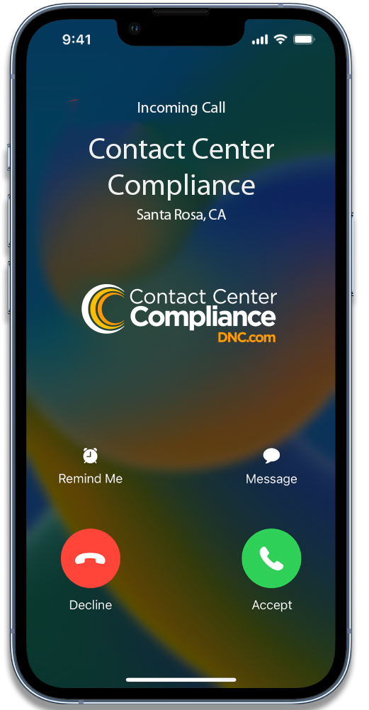
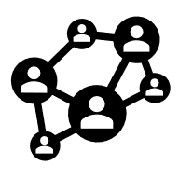
Rich Call Display
BCID is the only industry-led ecosystem engineered to deliver trusted, branded calls for enterprise businesses.
Onboarding Agents
Vetting
Agents
BCID ECOSYSTEM
Brands
Network Operators
Signing
Agents
Notes:
BCID is the only industry-led, Branded Calling ID, standards-based Rich Call Data (RCD) ecosystem engineered to be secure-by-design and to deliver trusted, branded calls nationwide for enterprise businesses. Standards based end-to-end security
Trusted ecosystem comprised of authorized partners who are vetted and audited
Caller telephone numbers, display names, logos, and call reasons are independently vetted and verified
Single uniform ecosystem ensures cross-network coverage
Callers receive confirmation that their branded calling information was delivered

Slide 14
Rich Call Display
Currently Verizon and T-Mobile have agreed to participate in the BCID ecosystem.
If a fraudster spoofs a BCID TN with A level attestation, the branding will fail.
Brands will need to partner with an onboarding agent.
Brands will need to make sure their dialer is integrated with a BCID approved signing agent.
Onboarding Agents
Vetting
Agents
BCID ECOSYSTEM
Brands
Network Operators
Signing
Agents

Slide 15
Supported OS
Make | Supported RCD Elements | OS
Motorola | Name, Logo, Call Reason | Android 14+
Samsung | Name, Logo, Call Reason | Android 14+
iPhone XS and newer | Name, Logo | iOS 18.5+

Slide 16
Facts & Limitations
Only will display if A level attestation is present from the approved signing agent.
The Rich Call Display will not display if the call traverses a non-IP network.
Not all devices support RCD.
AT&T will not be participating in the BCID ecosystem.
Onboarding Agents
Vetting
Agents
BCID ECOSYSTEM
Brands
Network Operators
Signing
Agents
Notes:
Despite signing calls with A level attestation, a large percentage

Slide 17
FAQs
Do I still need Number Reputation Management with RCD?
Can I change the call reason per call?
Does BCID work with iOS 26 Call Screening?
What percentage of calls will brand with RCD?
How can I find out if my dialer supports RCD?
Onboarding Agents
Vetting
Agents
BCID ECOSYSTEM
Brands
Network Operators
Signing
Agents

