Slide 1
When Carriers Turn Into Regulators
2025 Florida TCPA Summit
Notes:
How many of you guys feel like your outbound calls may be getting blocked by voice service providers?
How many of you guys feel like none of your calls get blocked by voice service providers?
Agenda:
How to identify call blocking
How to identify call labeling
2025 trends for call labeling
And help you guys take control of your calls and stop vsps from inaccurately blocking and labeling your traffic.

Slide 2
Robocall Epidemic
Despite all the work the FCC and terminating carriers have put in to stopping illegal robocalls:
US consumers STILL receive 3 – 5 billion robocalls per month.

Slide 3
Robocall Epidemic
Despite all the work the FCC and terminating carriers have put in to stopping illegal robocalls:
US consumers STILL receive 3 – 5 billion robocalls per month.
The first 5 months of 2025 saw an 11% increase in robocalls compared with 2024.

Slide 4
Robocall Epidemic
Despite all the work the FCC and terminating carriers have put in to stopping illegal robocalls:
US consumers STILL receive 3 – 5 billion robocalls per month.
The first 5 months of 2025 saw an 11% increase in robocalls compared with 2024.
The carriers have significantly ramped up call blocking & labeling in the last 6 months to combat the increase in robocalls.
Troutman correctly showed yesterday a recent drop in robocalls !

Slide 5
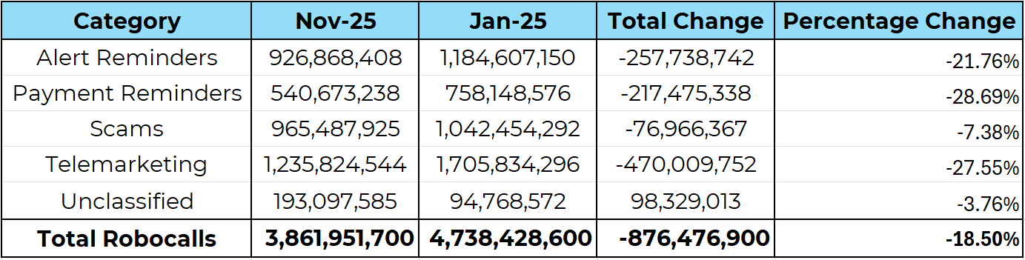
Robocalls by Category
Notes:
Despite the recent drop in robocalls, the battle is far from over.
According to Youmail, Scams only make up 25% of Robocalls in the U.S.

Slide 6
Historical Recap
Two approaches were taken to combat the robocall epidemic:
STIR/SHAKEN:
The FCC mandated carriers to authenticate calls that originates on its network with the goal of enabling the possibility for traceback & enforcement.
Call Labeling Analytics:
Separate from the FCC, the carriers took the approach using analytics to determine if a call is spam.

Slide 7
What does this mean?
As a result of these enforcement actions, illegal robocalls have certainly dropped as shown in the YouMail report.
That’s great!
Another result of this is that originating and intermediary carriers are under major scrutiny with the FCC for being shut down and have been significantly more careful about the traffic that originates and passes through their network.

Slide 8
What does this mean?
Specifically, intermediary providers have implemented measures to mitigate risky traffic on their network and it’s MAJORLY affecting legitimate businesses.
As downstream intermediary carriers are worried about passing illegal call traffic, they are now blocking calls AND improperly routing calls causing many of legitimate calls not to reach its proper destination causing for a major drop in contact rates.
Your low contact rates could be a direct result of your calls not even making it to the consumer phone!

Slide 9
Reasons for Intermediary Blocking
Intermediary carriers will block calls from TNs that are highly likely to be:
TNs that are unallocated, unassigned, unused, DNO;
TNs that are simply negatively categorized by any of the terminating carriers, even if the TN’s reputation is not severely negative.
TNs that have a history of calling the same TN repeatedly.
What percentage of my calls get blocked by intermediary carriers?

Slide 10
Call Blocking Rate by Attempt
SIP Code | Attempt 1 | Attempt 2 & 3 | Attempt 4 +
200 | 91.25% | 71.19% | 46.82%
403, 503, 603+ | 4.52% | 34.82% | 65.23%
Other | 4.23% | 28.32% | 12.05%
SIP Code | All Attempts
200 | 48.15%
403, 503, 603+ | 43.56%
Other | 8.23%

Slide 11
Case Study
We conducted an analysis of the call detail records ("CDRs") of this business to determine a benchmark of how the Successful Call rates and other data elements perform at prior to implementing Caller ID Remediation.
Successful Calls
SIP 200: The percentage of Successful Calls that were answered or went to voicemail. Any other SIP result is a not considered a Successful Call.

Slide 12
Case Study
Unsuccessful Calls
SIP 403, 503, 603, 604, 606, 607, & 608:
These SIP Codes consist of call blocking, rejection, declines, or service unavailable instances.
All of these SIP Codes represent 15.02% of all outbound calls.
Yes! That means 15.02% of their calls don’t even reach the consumer device!

Slide 13
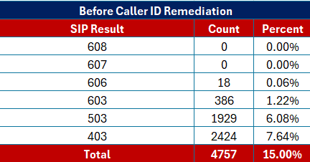
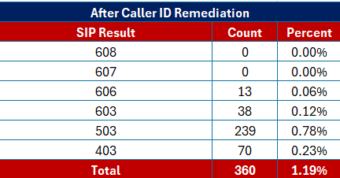
Call Blocking Rate by Reputation
How do failed SIP Codes change as TN Reputation is remediated?
TNs: 26
Percent Flagged: 41.15%
TNs: 26
Percent Flagged: 0.00%

Slide 14
Case Study
Unsuccessful Calls saw a 92.22% drop after implementing Caller ID Remediation.
Successful Calls saw a 22.81% increase after implementing Caller ID Remediation.
We also noted that SIP 487 saw a -27.84% change which is likely due to consumers picking up the phone before the call can be canceled by the agent.

Slide 15
Alternative to Call Blocking
Blatant Call Blocking is easily identifiable via SIP Codes. (Even when they are inconsistent)
However, we’re finding Intermediary carriers are sometimes choosing a highly illegal alternative to call blocking…

Slide 16
Alternative to Call Blocking
How come when I place a call from my cell phone to the consumer, they pick up nearly every time? But when I call from my dialer, I only get answered ~5% of the time?
How many of you have dealt with your call center agents complaining of “dead air”
Notes:
How many of you have dealt with your call center agents complaining of “dead air”

Slide 17
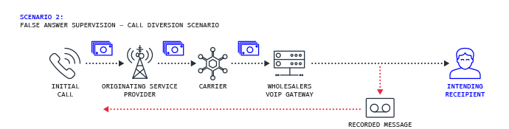
Alternative to Call Blocking
Intermediary Carriers will divert calls to a honeypot which will answer the call instead of blocking the call outright. Why?

Slide 18
Falsified Answered Calls
The official industry term – False Answer Supervision (“FAS”)
Definition: FAS is a form of telecom fraud where wholesale VOIP carriers will divert the call, falsifying an answer, and playing a recording to the caller.

Slide 19
Falsified Answered Calls
This means, wholesale VOIP carriers passing YOUR traffic are improperly routing your calls and DIVERTING your calls to these “black boxes” or “honeypots” and then falsifying a human answer instead of routing the call to the consumer.
Notes:
Earlier this year I performed a CDR analysis and investigated FAS on their traffic.
I found over 12% of their connected calls were FAS.

Slide 20
Alternative to Call Blocking
That way they can continue to charge for the call without having to pass the traffic downstream.
False Answer Supervision (FAS) is an illegal form of telecom fraud hurting businesses as calls are not reaching its intended destination making businesses believe the called number is a “bad” number.

Slide 21
Alternative to Call Blocking
Carriers using FAS today not just do it to increase billing, but they also do it to improperly route calls to avoid getting a C&D from the FCC.
Poor TN reputation increases the probability of FAS fraud.
FAS can still happen if you’re clean off all major carriers but flagged by an app company like Robokiller.
CCC can help you identify and eliminate FAS using our Caller ID Remediation engine.
FAS is an alternative to call blocking that wholesale VOIP carriers are using to stay under the radar.

Slide 22
Identifying FAS
FAS Identification at the carrier level can be remarkably challenging due to the dialers and carriers being unwilling to provide the necessary data to identify FAS.
However, If your carrier can successfully produce ALL the following data points, you can investigate FAS:
SIP Code, Terminating Media IP, Calling TN, Call(ed) TN, Call Duration.
But carriers are not always willing to cooperate and provide this data. If you’re lucky, they will give you SIP codes, but many dialers won’t even produce this data….
Notes:
you can take matters into your own hands and utilize the following data points:
Agent disposition, call duration, and SIP codes (if available).
We recommend adding three dispositions to your dialer so that your agents can begin reporting on dead air, music audio, and robotic/pre-recorded calls.
Recommended Dispositions To Track FAS:
Dead Air
Music Audio
Robot – Fake Human

Slide 23
Call Labeling
Otherwise Known As “Spam” Labeling

Slide 24
Call Labeling
Conversely to Call Blocking, Call Labeling is a tool used by terminating service providers to identify calls as potentially unwanted or illegal.
The goal of call labeling is to help protect consumers from telecom scams.
The major issue is that legitimate enterprises are also being labeled as spam without a reliable way to remediate their improperly flagged numbers.
How often are legitimate enterprise TNs negatively categorized?

Slide 25
YoY Call Labeling Trends
Carrier | 2023 | 2024 | 2025 (YTD)
TNs Scanned | 89,145 | 47,566 | 201,077
Verizon Flag % | 7.67% | 19.85% | 35.49%

Slide 26
YoY Call Labeling Trends
Carrier | 2023 | 2024 | 2025 (YTD)
TNs Scanned | 89,145 | 47,566 | 201,077
Verizon Flag % | 7.67% | 19.85% | 35.49%
ATT Flag % | 12.80% | 11.28% | 28.65%

Slide 27
YoY Call Labeling Trends
Carrier | 2023 | 2024 | 2025 (YTD)
TNs Scanned | 89,145 | 47,566 | 201,077
Verizon Flag % | 7.67% | 19.85% | 35.49%
ATT Flag % | 12.80% | 11.28% | 28.65%
T-Mobile Flag % | 8.71% | 3.75% | 05.03%

Slide 28
YoY Call Labeling Trends
Carrier | 2023 | 2024 | 2025 (YTD)
TNs Scanned | 89,145 | 47,566 | 201,077
Verizon Flag % | 7.67% | 19.85% | 35.49%
ATT Flag % | 12.80% | 11.28% | 28.65%
T-Mobile Flag % | 8.71% | 3.75% | 05.03%
Overall Flag % (All Carriers) | 29.17% | 34.87% | 69.17%

Slide 29
2025 Call Labeling Trends
Carrier | Q1 + Q2 | Q3 + Q4 | All of 2025
TNs Scanned | 106,963 | 94,114 | 201,077
Verizon Flag % | 33.69% | 37.54% | 35.49%

Slide 30
2025 Call Labeling Trends
Carrier | Q1 + Q2 | Q3 + Q4 | All of 2025
TNs Scanned | 106,963 | 94,114 | 201,077
Verizon Flag % | 33.69% | 37.54% | 35.49%
ATT Flag % | 28.94% | 28.32% | 28.65%

Slide 31
2025 Call Labeling Trends
Carrier | Q1 + Q2 | Q3 + Q4 | All of 2025
TNs Scanned | 106,963 | 94,114 | 201,077
Verizon Flag % | 33.69% | 37.54% | 35.49%
ATT Flag % | 28.94% | 28.32% | 28.65%
T-Mobile Flag % | 1.49% | 9.05% | 05.03%

Slide 32
2025 Call Labeling Trends
Carrier | Q1 + Q2 | Q3 + Q4 | All of 2025
TNs Scanned | 106,963 | 94,114 | 201,077
Verizon Flag % | 33.69% | 37.54% | 35.49%
ATT Flag % | 28.94% | 28.32% | 28.65%
T-Mobile Flag % | 1.49% | 9.05% | 05.03%
Overall Flag % (All Carriers) | 64.13% | 74.90% | 69.17%

Slide 33
YoY Spam Labeling Trends
T-Mobile recently revamped their algorithms which significantly ramped up the percentage of flagged numbers.
Verizon ALSO recently revamped their algorithms in Q3 2025, causing a dramatic increase in spam labeling on legitimate enterprise TNs.
As the carriers continue to earn revenue from branded calling services and spam protection services, inaccurate spam labeling continues to be on the rise, destroying legitimate business’ ability to conduct lawful business via the phone.

Slide 34
Inbound Call Labeling Trends
Just when things couldn’t get worse….
Inbound Calls are not safe either. T-Mobile recently started notifying consumers whenever they are calling a flagged number.

Slide 35
Common Dialing Practices
That will cause your TNs to get marked as spam

Slide 36
Common Bad Dialing Practices
Double/Triple Tapping: This dialing practice is frowned upon and destroys your brand’s reputation.

Slide 37
Common Bad Dialing Practices
Double/Triple Tapping: This dialing practice is frowned upon and destroys your brand’s reputation.
Calling more than three times per day: This dialing practice is frowned upon, and many states limit sales calls to three attempts per twenty-four hours on the same matter or issue.

Slide 38
Common Bad Dialing Practices
Double/Triple Tapping: This dialing practice is frowned upon and destroys your brand’s reputation.
Calling more than three times per day: This dialing practice is frowned upon, and many states limit sales calls to three attempts per twenty-four hours on the same matter or issue.
Not De-Duping Leads: When a consumer fills out a lead form multiple times, this commonly triggers multiple leads in the ecosystem causing the dialer to call the consumer more than intended.

Slide 39
Common Bad Dialing Practices
Number Rotation: Using multiple numbers within the same area code to call the same consumer to avoid being flagged as spam. This practice is used by fraudulent callers and is a very bad dialing practice that hurts your TN reputation further.

Slide 40
Common Bad Dialing Practices
Calling Co-Reg Leads: While not necessarily illegal, it is recommended to avoid purchasing leads that are being sold to many other businesses as this often causes consumers to complain.
We have found that co-reg leads are much quicker to report a TN as spam because they are already being called by many other businesses.
While your business may be following compliance and dialing best practices (3 calls / day maximum), the consumers are much quicker to complain when their information is sold to 20 different call centers.

Slide 41
Vetting Ecosystem
Designed to “Raise your hand” as a good actor and remediate TNs

Slide 42
Vetting Ecosystem
We are excited to announce that we recently revamped our vetting ecosystem which significantly improves our ability to effectively and accurately vet businesses to protect them from inaccurate labeling.
As a result, we’re now able to achieve significantly faster remediation timeframes which a much higher success rate.

Slide 43
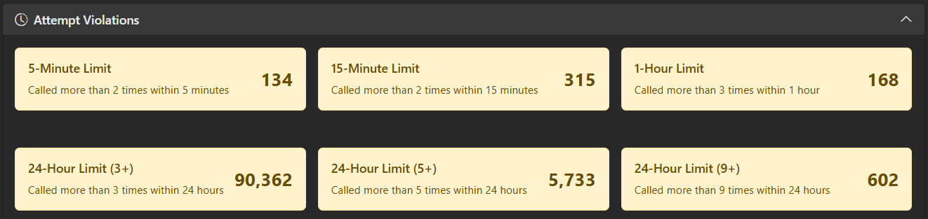
CDR Analysis
Our new vetting ecosystem now includes in-depth CDR analysis that will audit every call your brand places to ensure your brand is following state and federal compliance regulations.

Slide 44
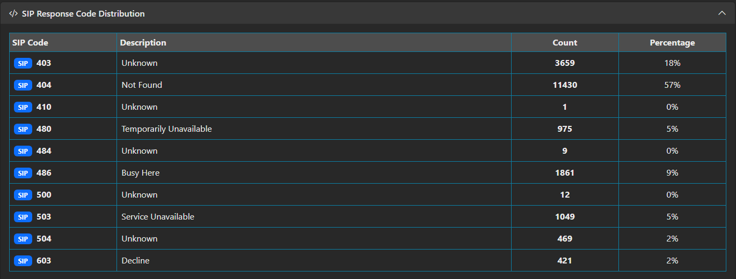
CDR Analysis

Slide 45
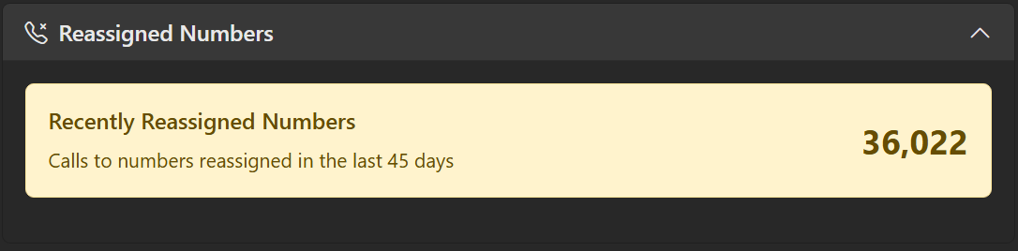
CDR Analysis
Our new vetting ecosystem now includes in-depth CDR analysis that will audit every call your brand places to ensure your brand is following state and federal compliance regulations.
Using the CDR tool, we’ve been able to identify when bad actors are spoofing the brand’s TNs.

Slide 46
Vetting Ecosystem
Through our improved end-to-end vetting ecosystem:
Enterprises now can “raise their hands” as good actors in the calling ecosystem and restore trust back to the phone and;
Absolve nearly 100% of inaccurate labeling and;
Identify when fraudsters spoof your TNs and;
Identify areas of non-compliance through in-depth CDR analysis.

Slide 47
Vetting Ecosystem
Through our improved end-to-end vetting ecosystem:
Enterprises can now prevent intermediary carriers from blocking and diverting calls and;
Significantly reduce TN Inventory and;
Dial smarter, not harder.
The majority of users who have been approved in the new vetting ecosystem are 100% clean off all carriers and have seen a significant improvement in connect rates and an improved cx.

Slide 48
Questions?
Email me as well to chat: Ronnie@DNC.com

